Slide 1
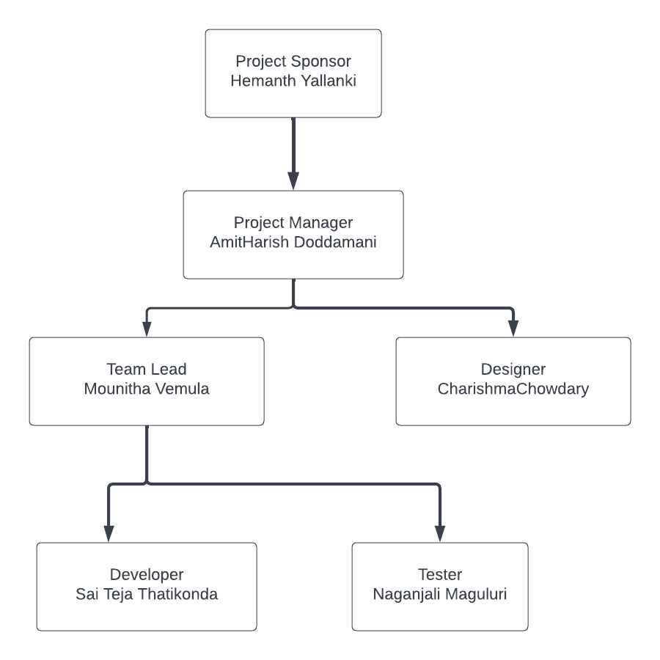
Design and launch a course online Date:06/20/2023

